Slide 1
Runge-Kutta 4th Order Method
by
Dr. Md. Rajibul Islam
CSE, UAP

Slide 2
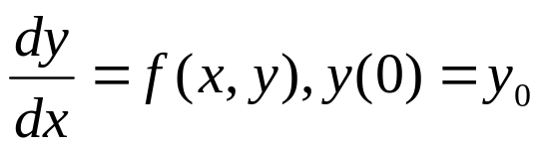
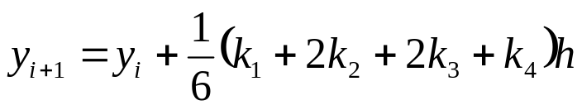

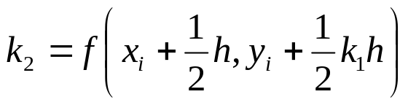
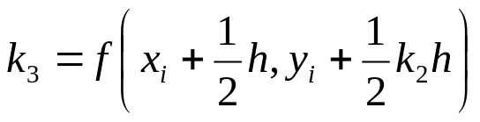

Runge-Kutta 4th Order Method
For
Runge-Kutta took this particular expression and equated it to the second-order . . . the first five terms of the Taylor series expansion for y
Runge Kutta 4th order method is given by
where

Slide 3
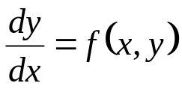
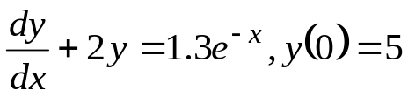
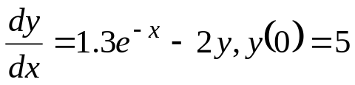

How to write Ordinary Differential Equation
How does one write a first order differential equation in the form of
Example
is rewritten as
In this case

Slide 4
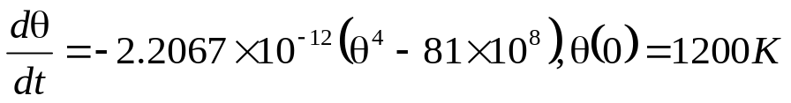


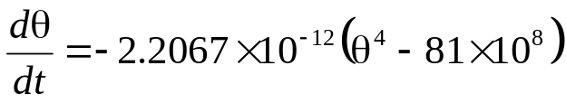
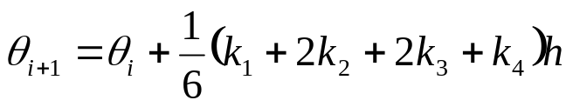
Example
A ball at 1200K is allowed to cool down in air at an ambient temperature of 300K. Assuming heat is lost only due to radiation, the differential equation for the temperature of the ball is given by
Find the temperature at
seconds using Runge-Kutta 4th order method.
Assume a step size of
seconds.

Slide 5

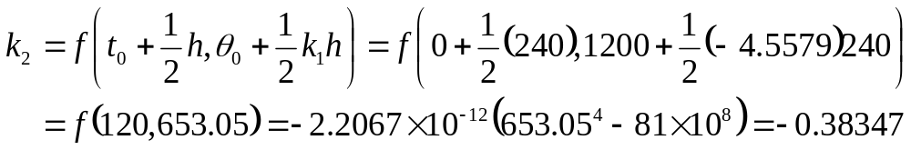
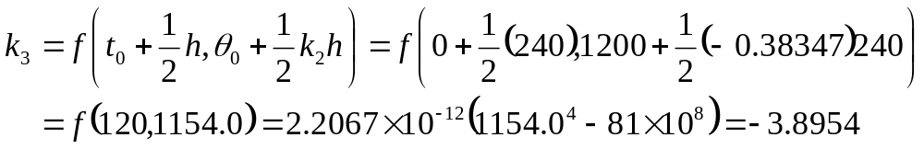
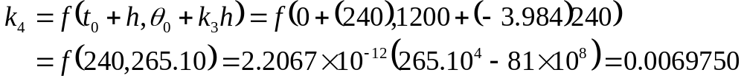
Solution
Step 1:

Slide 6
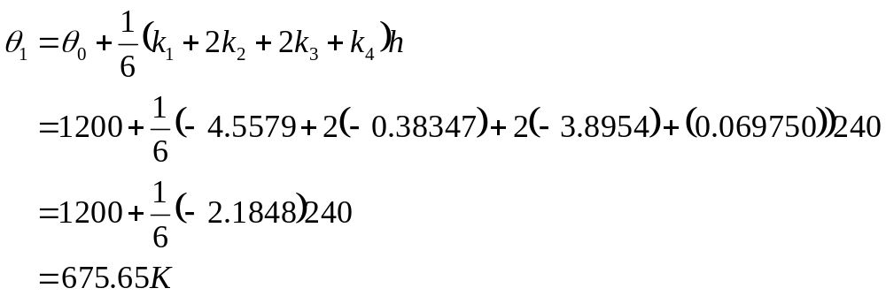



Solution Cont
is the approximate temperature at

Slide 7

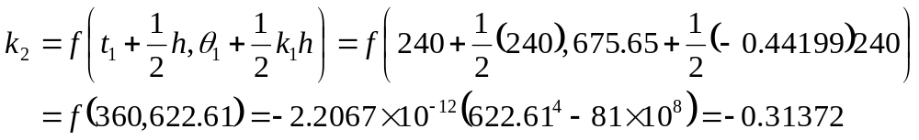
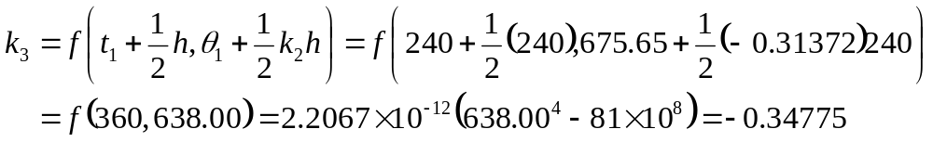
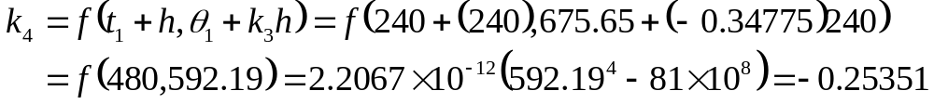
Solution Cont
Step 2:

Slide 8
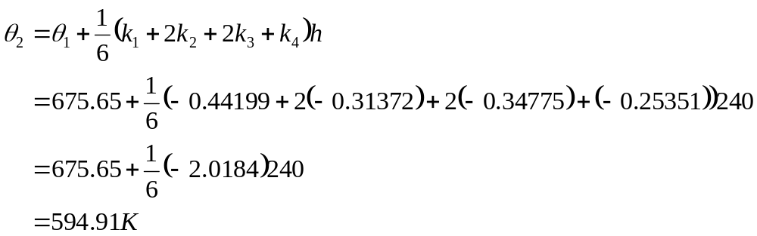


Solution Cont
θ₂ is the approximate temperature at

Slide 9

Solution Cont
The exact solution of the ordinary differential equation is given by the solution of a non-linear equation as
The solution to this nonlinear equation at t=480 seconds is

Slide 10
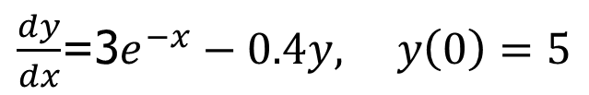
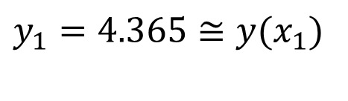


Test 1
Find y(3) using Runge-Kutta 4th order method where h=1.5
K1=1
K2=-0.8829
K3=-0.3180
K4=-1.140

Slide 11
Test 1
K1=-1.076
K2=-1.107
K3=-1.098
K4=-0.9379
y2=2.759
x2=X1+h=1.5+1.5=3.0
y2=y(x2)
=y(3)~=2.759

Slide 12
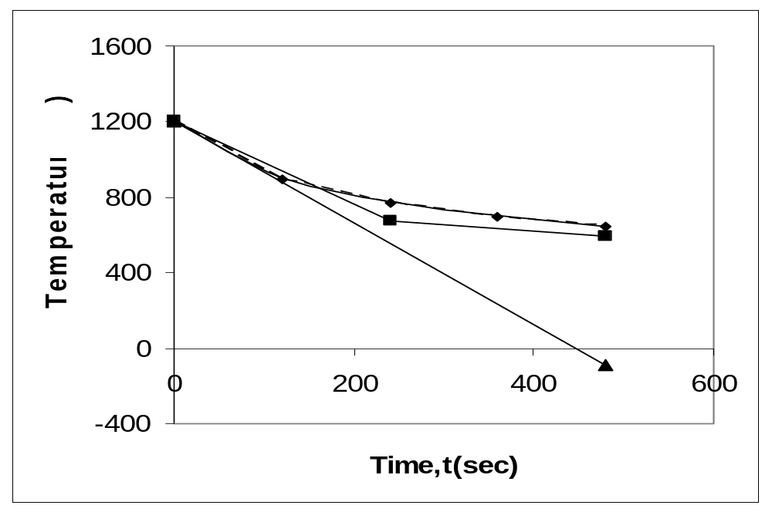
Comparison with exact results
Figure 1. Comparison of Runge-Kutta 4th order method with exact solution

Slide 13
Effect of step size
Table 1. Temperature at 480 seconds as a function of step size, h
Step size, h | θ (480) | E_{t} | |є_{t}|%
480 240 120 60 30 | −90.278 594.91 646.16 647.54 647.57 | 737.85 52.660 1.4122 0.033626 0.00086900 | 113.94 8.1319 0.21807 0.0051926 0.00013419
(exact)

Slide 14
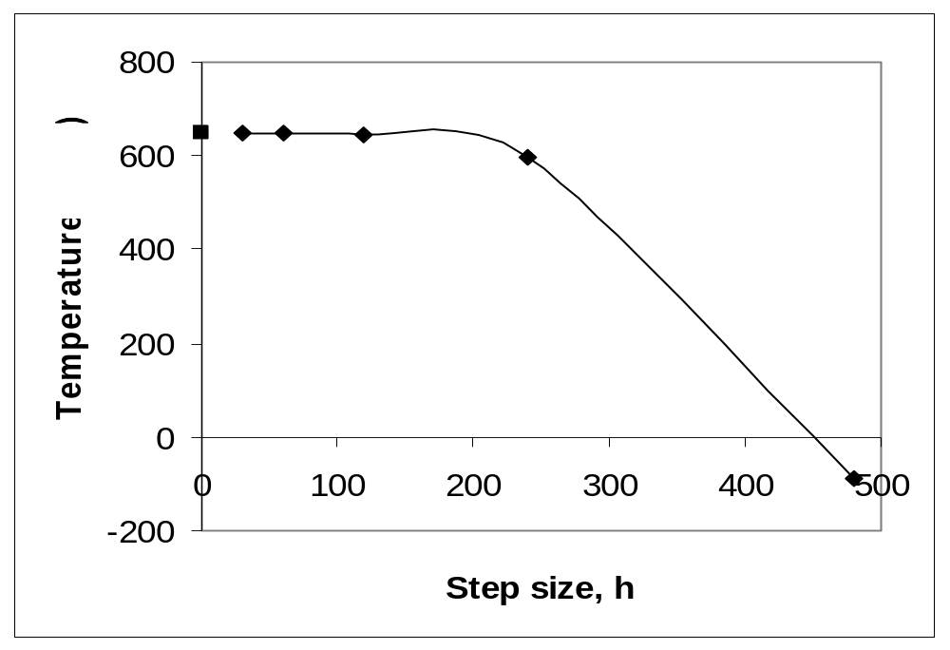
Effects of step size on Runge-Kutta 4th Order Method
Figure 2. Effect of step size in Runge-Kutta 4th order method

Slide 15
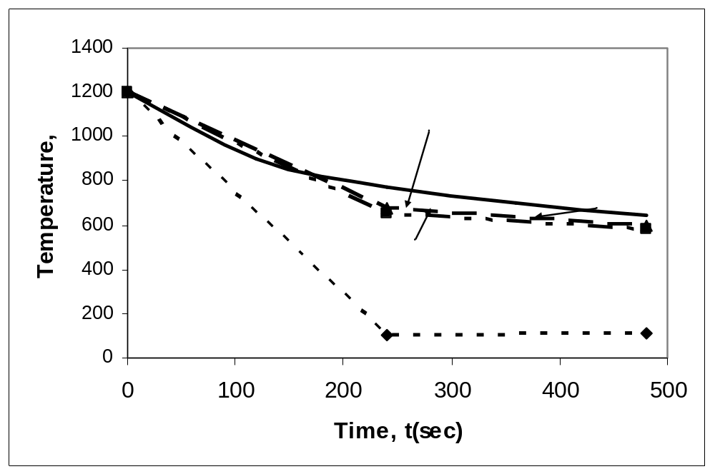
Comparison of Euler and Runge-Kutta Methods
Figure 3. Comparison of Runge-Kutta methods of 1st, 2nd, and 4th order.

Slide 16
THE END

